Slide 1
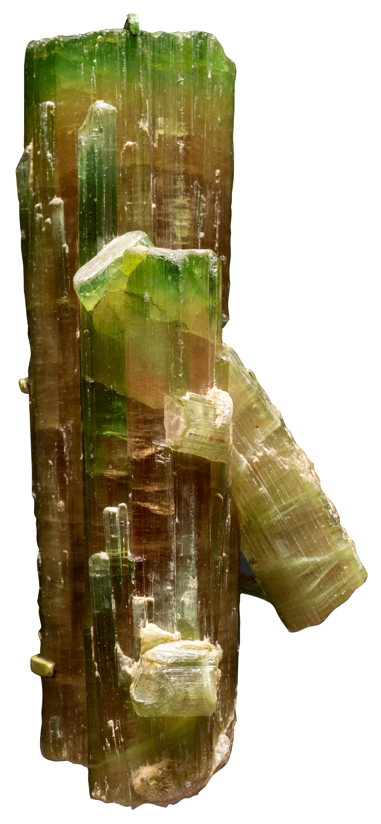
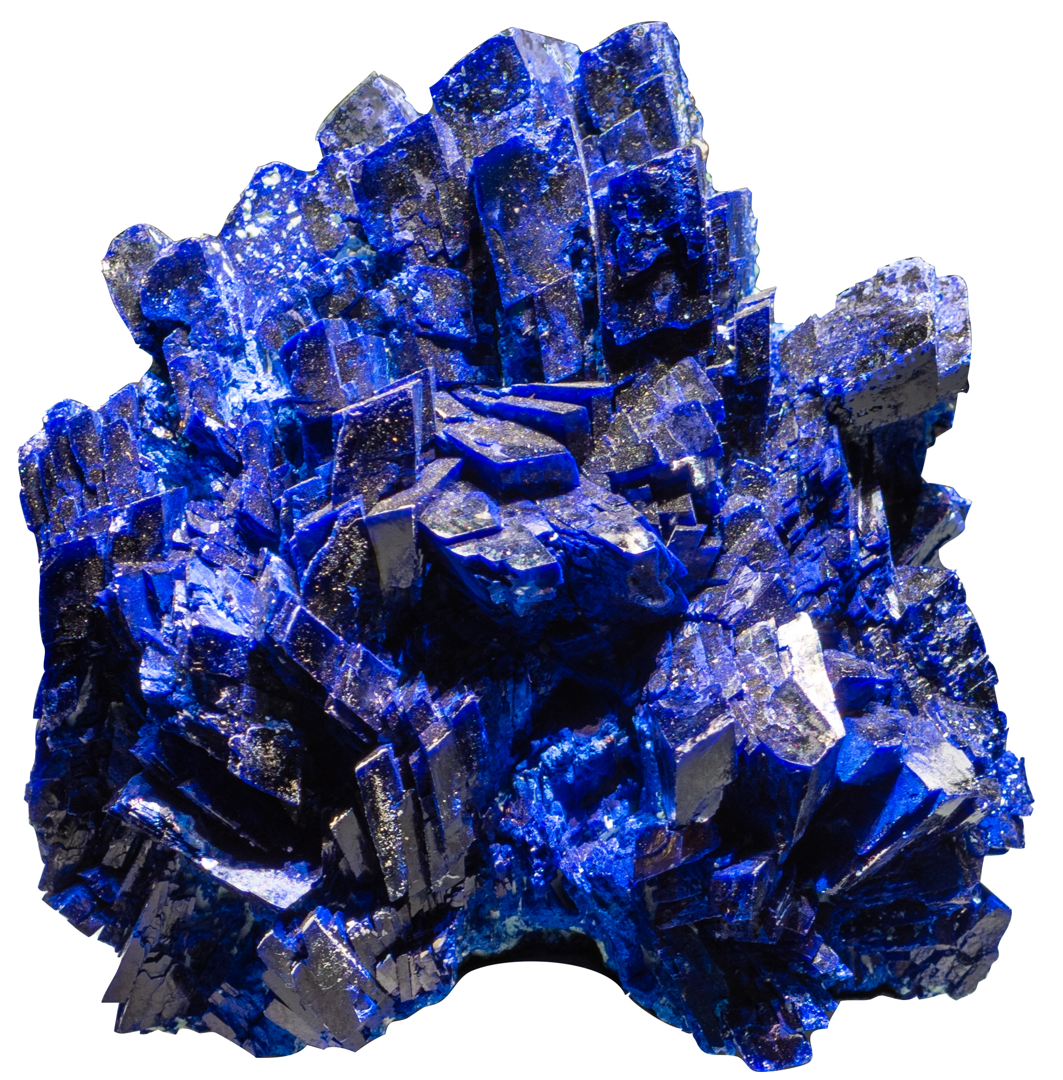
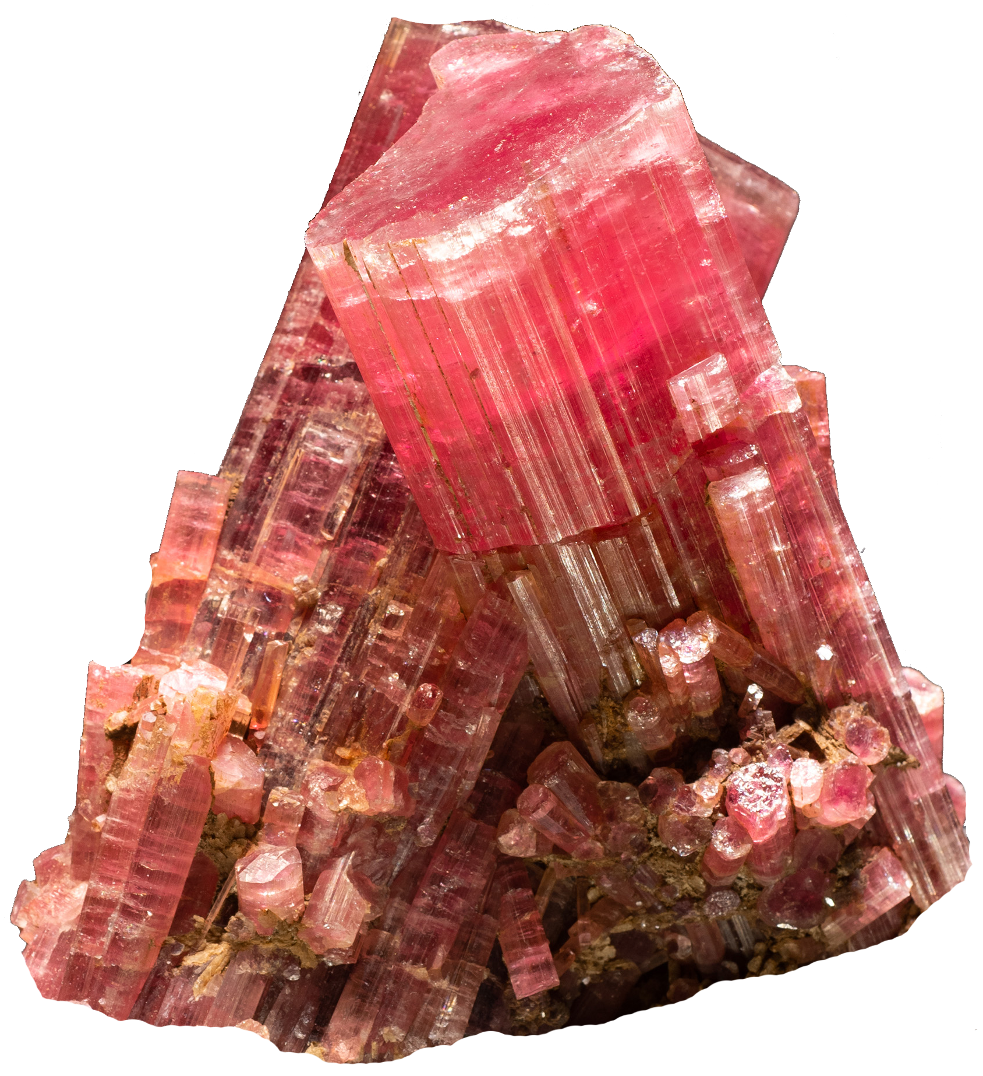
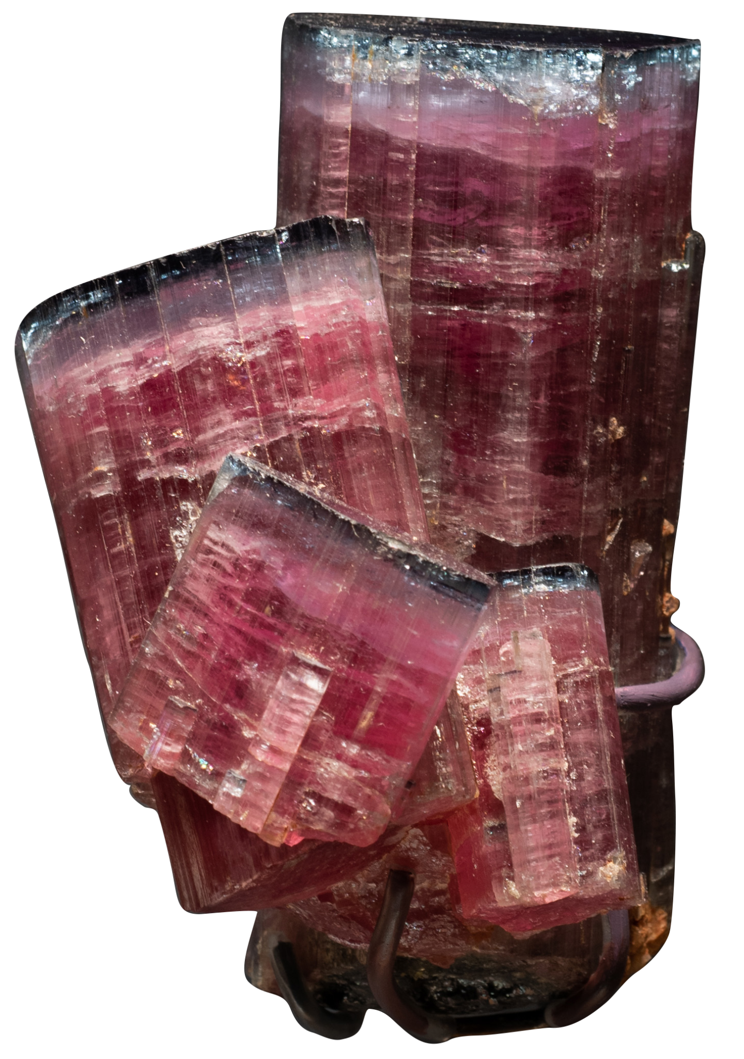
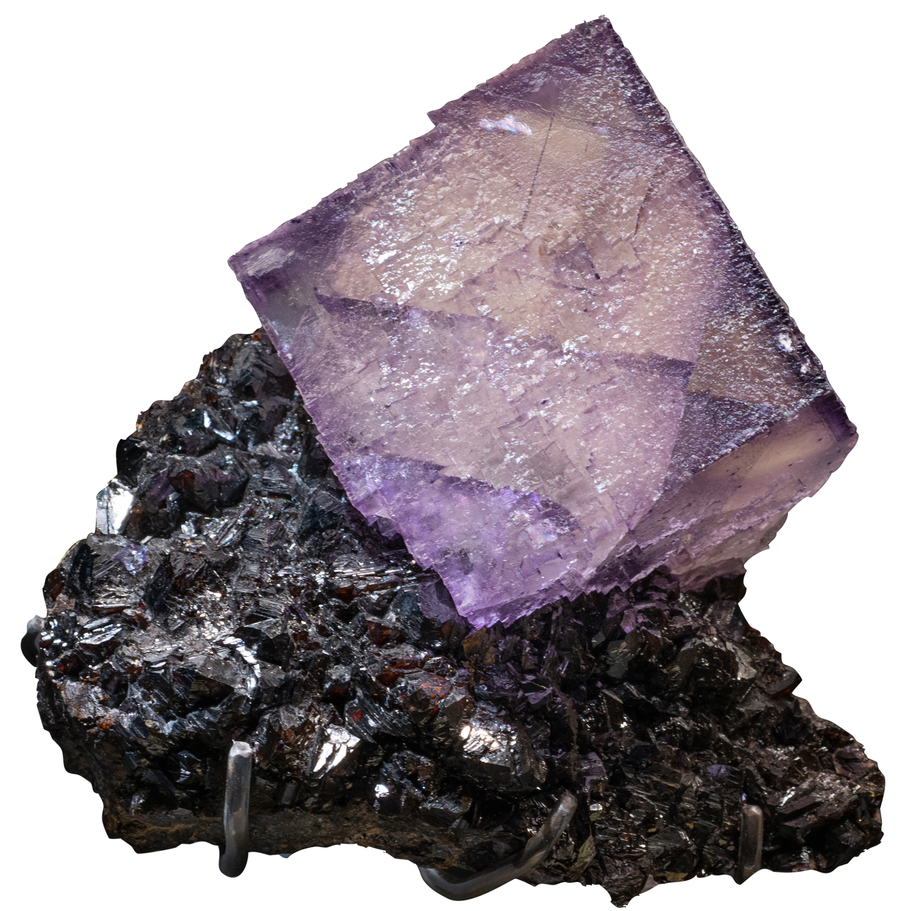
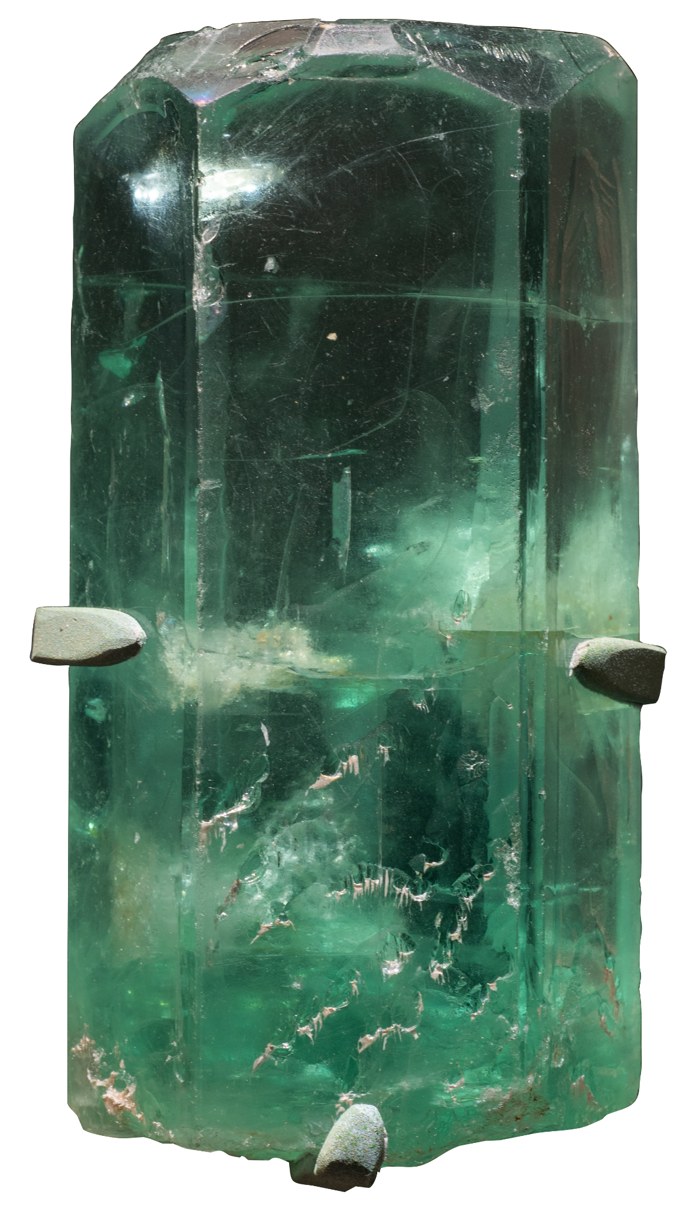
Observe the Colors and Shapes of Minerals
Notes:
Notes for Educator
This engagement activity uses the Visual Thinking Strategy (VTS) to help students practice observation, thinking, listening, and communication skills.
This slideshow contains two parts:
Part 1 explores three different minerals to help students understand that:
minerals come in different colors and shapes
Part 2 explores three specimens of the same mineral to help students understand that:
there is a diversity of color even within one mineral family
crystal shape is a characteristic used to help group and classify minerals
Each part concludes with a slide to help students general questions about minerals and their colors, shapes, and sizes. These questions can be recorded on a class or group chart, and be used as prompts for discussion after their Museum visit and/or for further research.

Slide 2
Part 1
Notes:
Notes for Educator
Part 1 explores three different specimens to help students understand that minerals come in different colors and shapes.

Slide 3
In this activity, you will…
Explore three minerals and their colors and shapes
Notes:
Notes for Educator
The specimens that students will explore progress from a single crystal (beryl), to a mineral with multiple crystals (azurite), and finally, a specimen that contains two different minerals (fluorite and sphalerite).

Slide 4
Look closely…
What do you see?

Slide 5
What do you notice about…
Color?
Shape?
Notes:
Notes for Educator
This is one single crystal
The mineral is beryl
Beryl’s crystal shape is hexagonal

Slide 6
Look closely…
What do you see?

Slide 7
What do you notice about…
Color?
Shape?
Notes:
Notes for Educator
There are many crystals of the same mineral
The mineral is azurite
Azurite’s crystal shape is monoclinic

Slide 8
Look closely…
What do you see?

Slide 9
What do you notice about…
Color?
Shape?
Notes:
Notes for Educator
There are two minerals:
Fluorite (light purple; crystal shape: cubic)
Sphalerite (black; crystal shape: dodecahedral)

Slide 10
What questions do you have about…
minerals and their colors and shapes?
Notes:
Notes for Educator
Questions can be recorded on a class or group chart so that students can revisit the questions after their trip to the Museum and/or use them as prompts for further research.

Slide 11
Part 2
Notes:
Notes for Educator
Part 2 explores three specimens of the same mineral (tourmaline) to help students understand that:
there is a diversity of color even within one mineral family
crystal shape is a characteristic used to help group and classify minerals

Slide 12
In this activity, you will explore…
a mineral called tourmaline

Slide 13
Look closely…
What do you see?

Slide 14
What do you notice about…
Color?
Shape?

Slide 15
Look closely…
What do you see?

Slide 16
What do you notice about…
Color?
Shape?

Slide 17
Look closely…
What do you see?

Slide 18
What do you notice about…
Color?
Shape?

Slide 19
Compare the tourmalines…
How are they different?
Notes:
Notes for Educator
Differences include color and size of crystals

Slide 20
Compare the tourmalines…
How are they similar?
Notes:
Notes for Educator
Guide students to notice that crystal shape is a common characteristic
Tourmaline’s crystal shape is hexagonal

Slide 21
What questions do you have about…
minerals and their colors and shapes?
Notes:
Notes for Educator
Questions can be recorded on a class or group chart so that students can revisit the questions after their trip to the Museum and/or use them as prompts for further research.

