Slide 1
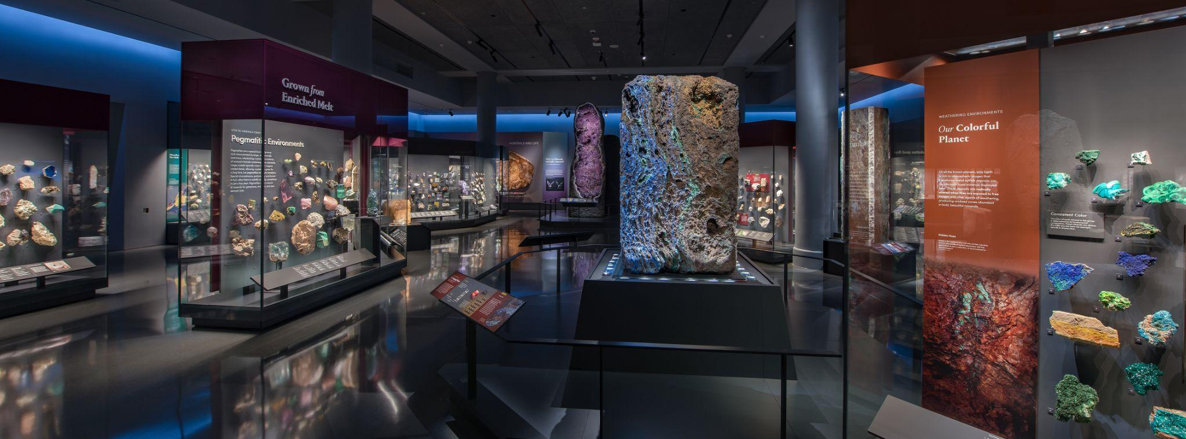
Mignone Halls of Gems and Minerals
GRADES 9–12 • PHYSICAL SCIENCE
In this activity, you will…
Observe minerals that are used by humans in everyday life
Notes:
Notes for Educator
This activity includes two parts:
Part 1: Before the Museum Visit
Part 2: After the Museum Visit

Slide 2
Part 1
Before the Museum Visit
Mignone Halls of Gems and Minerals
GRADES 9–12 • PHYSICAL SCIENCE
Notes:
Notes for Educator
Part 1 is an engagement activity that uses the Visual Thinking Strategy (VTS) to help students practice observation, thinking, listening, and communication skills.
The concluding slide invites students to generate questions about minerals and their properties that make them suitable for human use. These questions can be recorded on a class or group chart, and be used as prompts for discussion after their Museum visit and/or for further research.

Slide 3
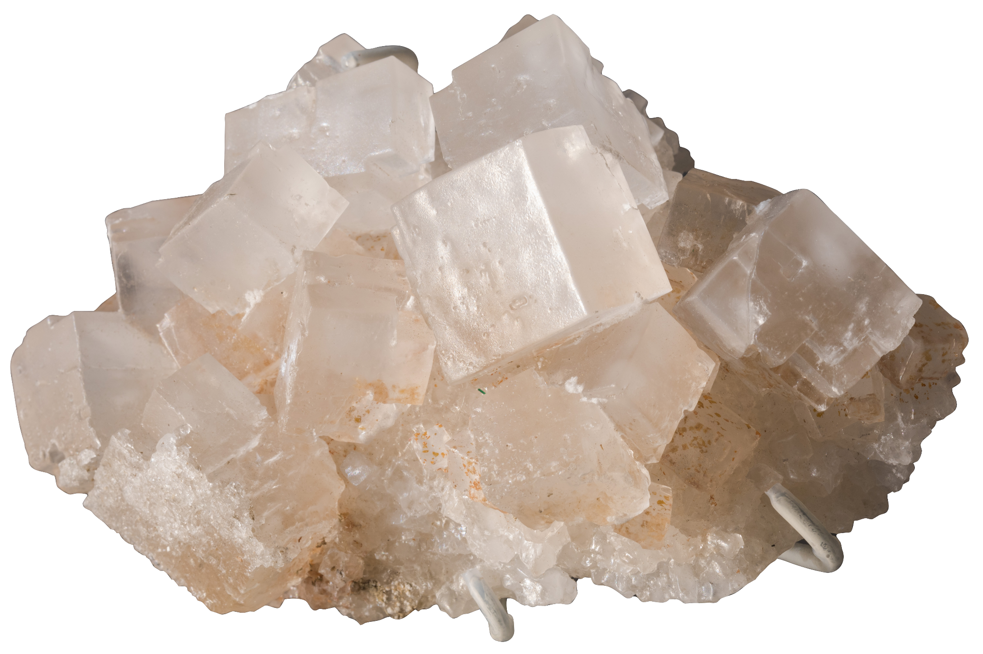
Look closely…
What do
you see?

Slide 4
What do you notice about its…
Color?
Shape?
Crystal size?

Slide 5
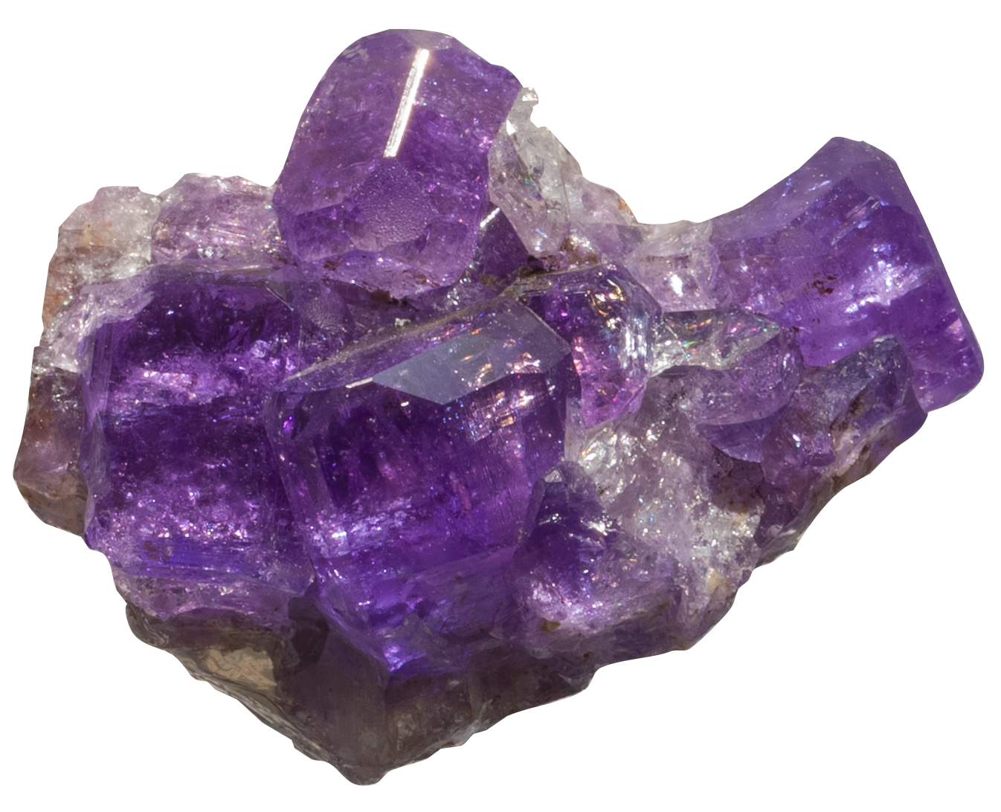
Look closely…
What do you see?

Slide 6
What do you notice about its…
Color?
Shape?
Crystal size?

Slide 7
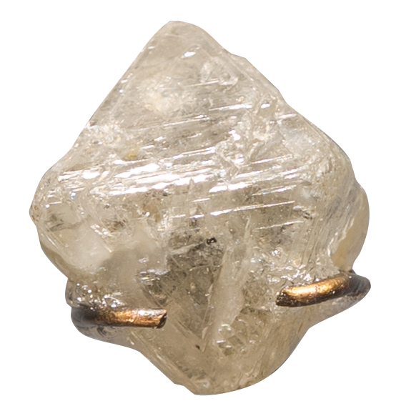
Look closely…
What do you see?

Slide 8
What do you notice about its…
Color?
Shape?
Crystal size?

Slide 9
What questions do you have about…
how humans might use these minerals in our everyday life?
Notes:
Notes for Educator
Questions can be recorded on a class or group chart so that students can revisit the questions after their trip to the Museum and/or use them as prompts for further research.
Additional suggested prompts:
What is similar or different about these minerals?
If humans want to use these minerals, what other information would we need to know about them?
Tell students that when they visit the Museum, they are going to investigate how the properties of minerals determine how humans might use them.

Slide 10
Part 2
After the Museum Visit
Mignone Halls of Gems and Minerals
GRADES 9–12 • PHYSICAL SCIENCE
Notes:
Notes for Educator
Students revisit the same specimens from Part 1.
Students use their observations and what they’ve learned at the Museum and in the group discussions to figure out how the properties of each mineral inform how humans might use it.

Slide 11
What connections can you make between this mineral’s usage and its properties and chemical composition?
Support your inference based on what you learned.
HALITE
Uses: deicing streets and sidewalks
Chemical Formula: NaCL
Hardness: 2
Cleavage & Fracture: 3 perfect at 90°
Tenacity: brittle, easily shattered
Color: clear or white
Transparency: transparent to translucent

Slide 12
What connections can you make between this mineral’s usage and its properties and chemical composition?
Support your inference based on what you learned.
APATITE
Uses: decorative jewelry
Chemical Formula: Ca₅(PO₄)₃(Cl/F/OH)
Hardness: 5
Cleavage & Fracture: good cleavage in one direction (can be easily split along a flat plane)
Color: vivid color, e.g. green, blue, yellow, pink
Transparency: usually transparent to translucent; some varieties opaque
Notes:
Notes for Educator
Apatite is fragile. But because of its transparency, brilliance, and vivid colors, it is often used as a protected accent stone in a pendant or brooch.

Slide 13
What connections can you make between this mineral’s usage and its properties and chemical composition?
Support your inference based on what you learned.
DIAMOND
Uses: jewelry; industrial uses (drilling, cutting, grinding, polishing)
Chemical Formula: C
Hardness: 10
Cleavage & Fracture: 4 cleavage planes (can split into 4 pieces)
Optical Properties: high refraction; high luster
Color: white, yellow, blue, pink
Transparency: transparent

