Slide 1
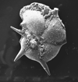
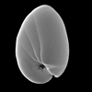
MICROFOSSIL CONSERVATION
Notes:
Planktonic Foram: Hantkenina alabamensis – Cushman 1925
Benthic Foram: Nonionelaa opima – Cushman 1947

Slide 2

MICROFOSSIL CONSERVATION
Notes:
Planktonic Foram: Hantkenina alabamensis – Cushman 1925

Slide 3
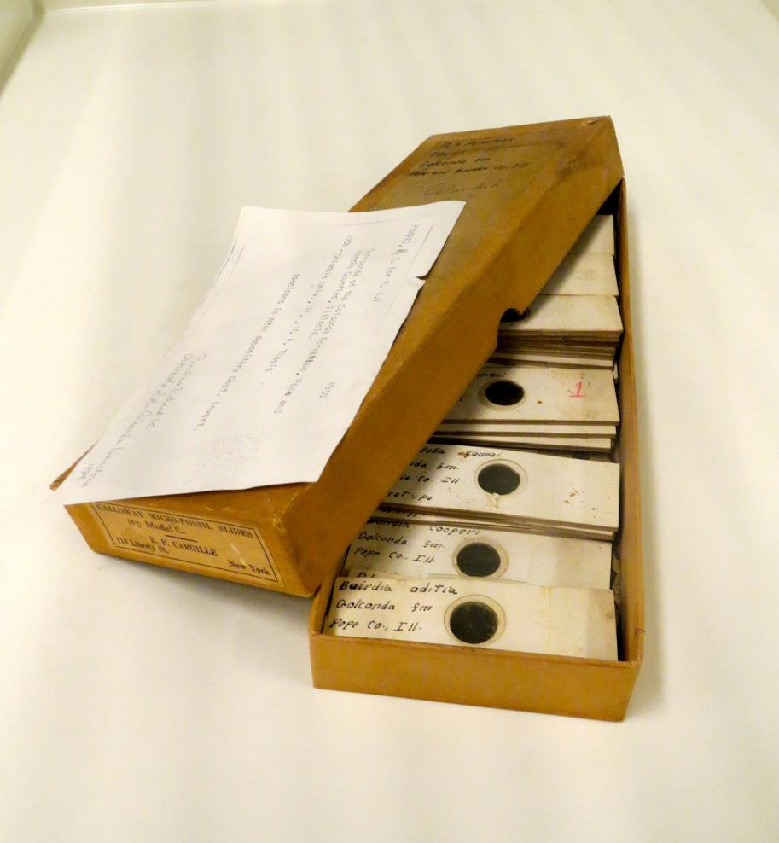
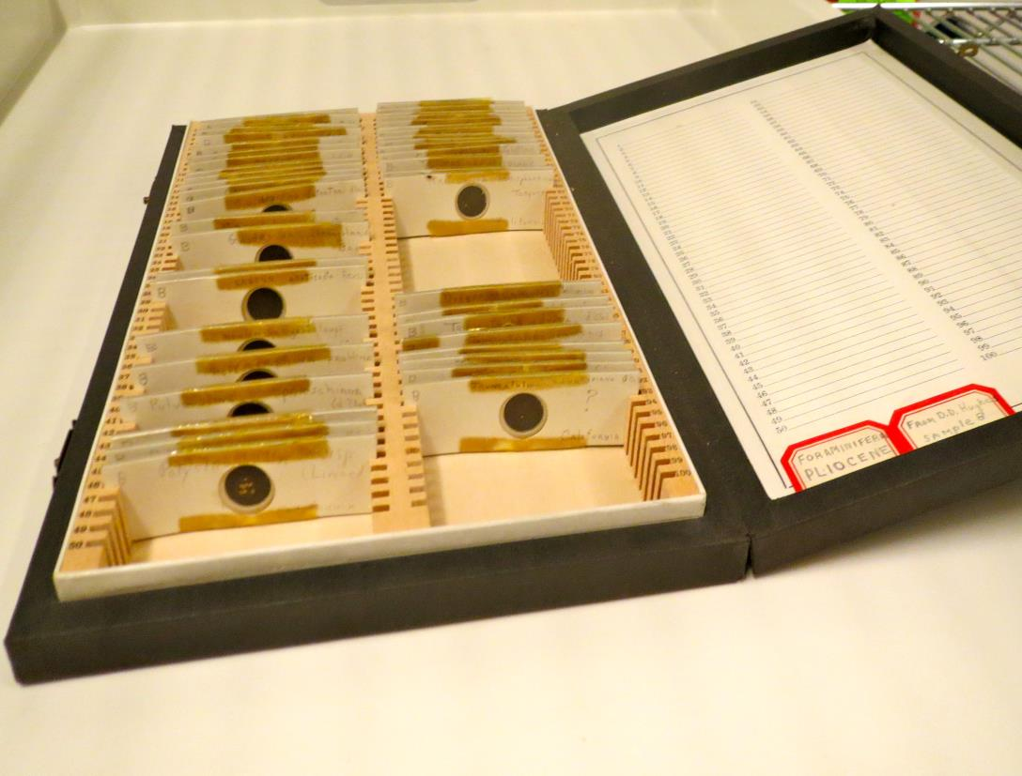
THE CHALLENGE

Slide 4
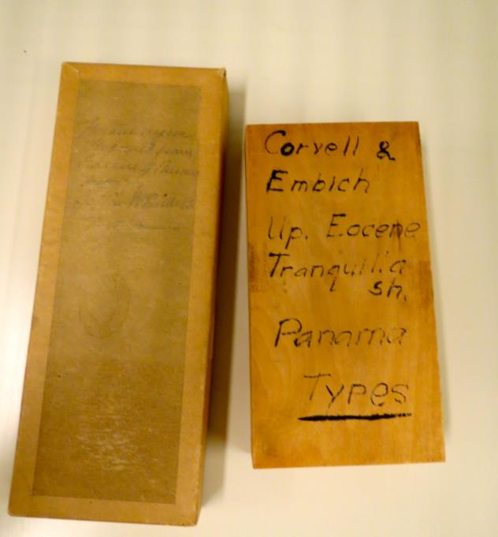
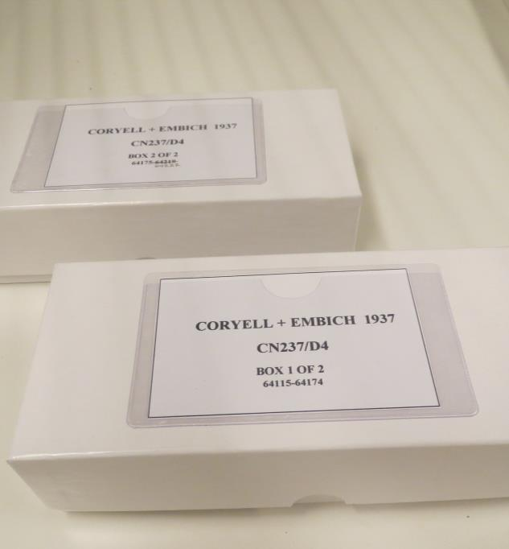
GETTING FROM A. TO B.
A.
B.

Slide 5
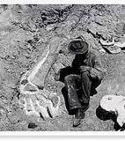
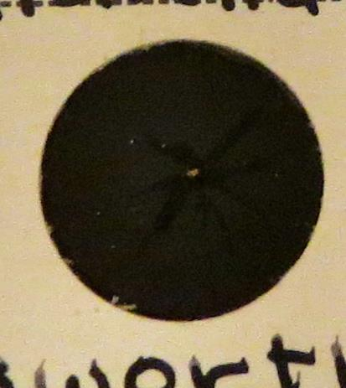
SIZE MAKES A DIFFERENCE

Slide 6
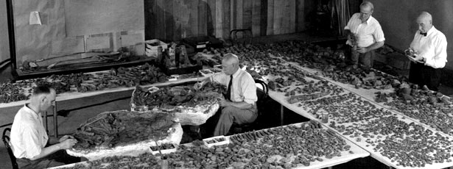
PROTOCOL

Slide 7
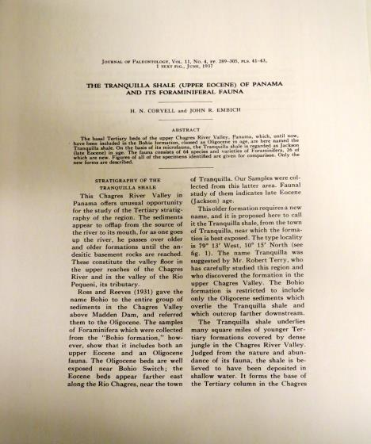
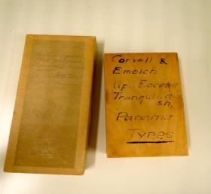
FIND PUBLICATION

Slide 8
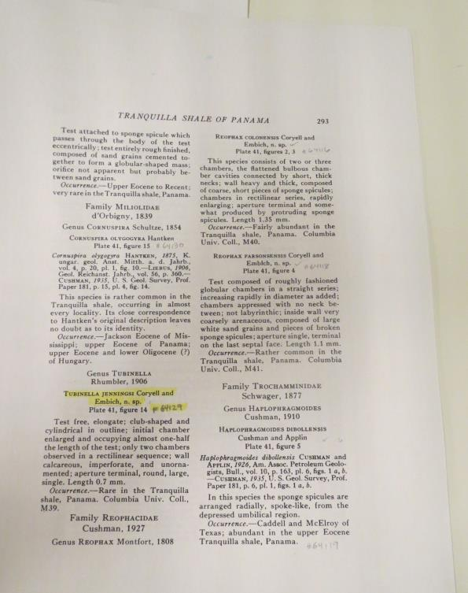
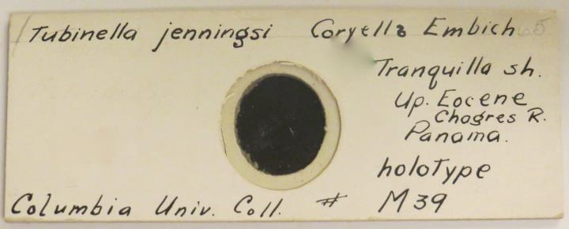
FIND SPECIMENS IN PUBLICATION
Notes:
Check all specimens against the publication. If a specimen is missing note this in publication.

Slide 9
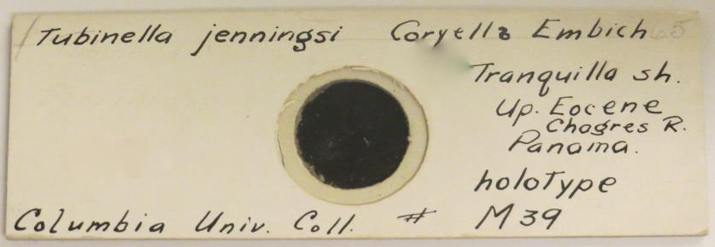
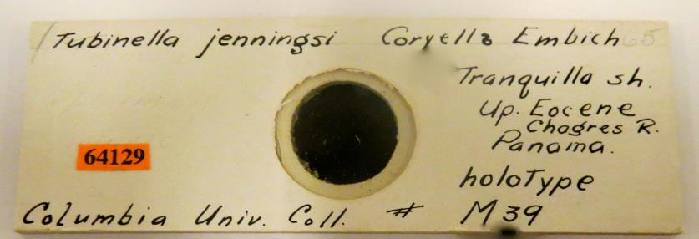
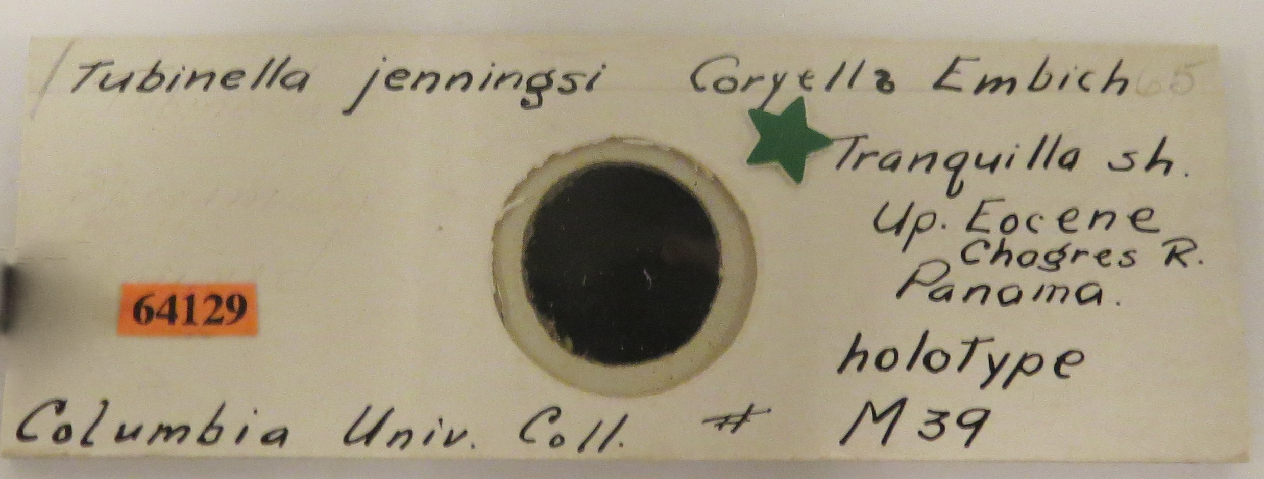
1. If specimen has an old Col.
Univ. #
2. Give new AMNH # to specimen
3. If specimen is a holotype
add a small green star

Slide 10

4. If a new number has been
added to a specimen note
new number in publication.

Slide 11
HOUSING

Slide 12
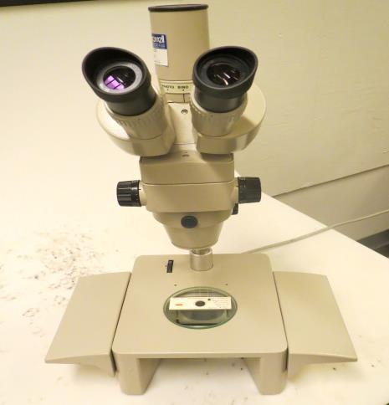
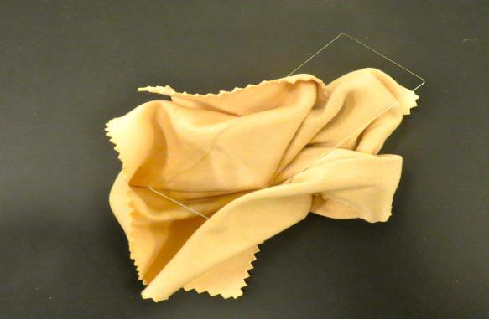
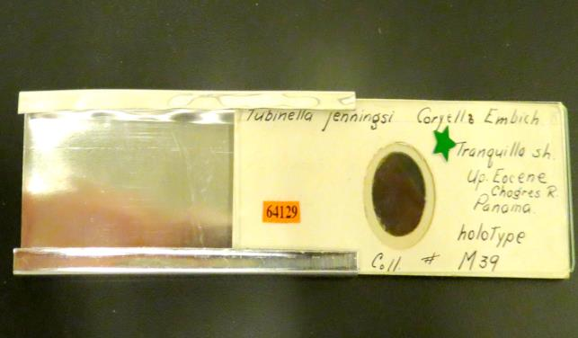
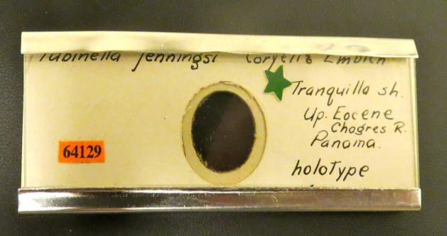
Notes:
Verify presence of specimen – clean glass cover – clean metal housing

Slide 13
ENTER INTO DATA BASE

Slide 14
PRINT NEW AMNH LABELS

Slide 15
PREPARING STORAGE BOXES

Slide 16
PHOTO

Slide 17
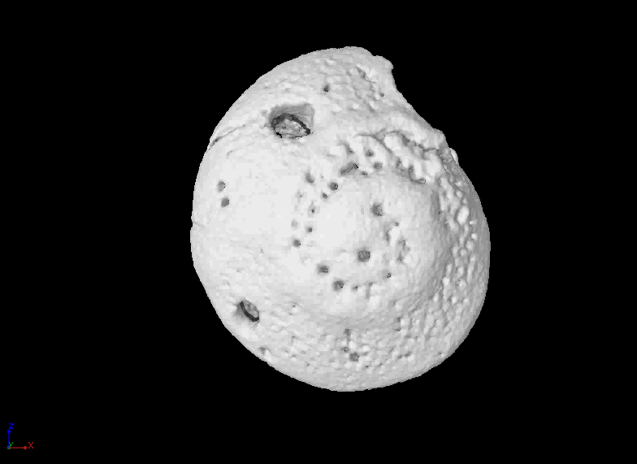

Slide 18
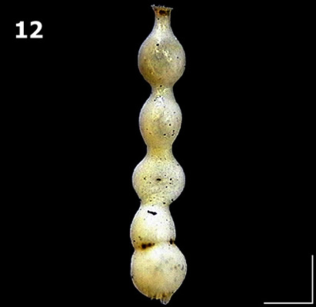

Slide 19
UPLOAD TO DATA BASE

Slide 20
FILE

